Slide 1



Overview of Pixel offline activities
Danek KOTLINSKI¹ , Tamas Almos VAMI²
¹ PSI
² Johns Hopkins University
Tracker DPG meeting

Slide 2
Introduction
There are several talks in the agenda, for those topics I will let the speakers introduce the tasks
Here I am showing what is not mentioned in details in these talks and the projects for which we need PERSON-POWER

Slide 3
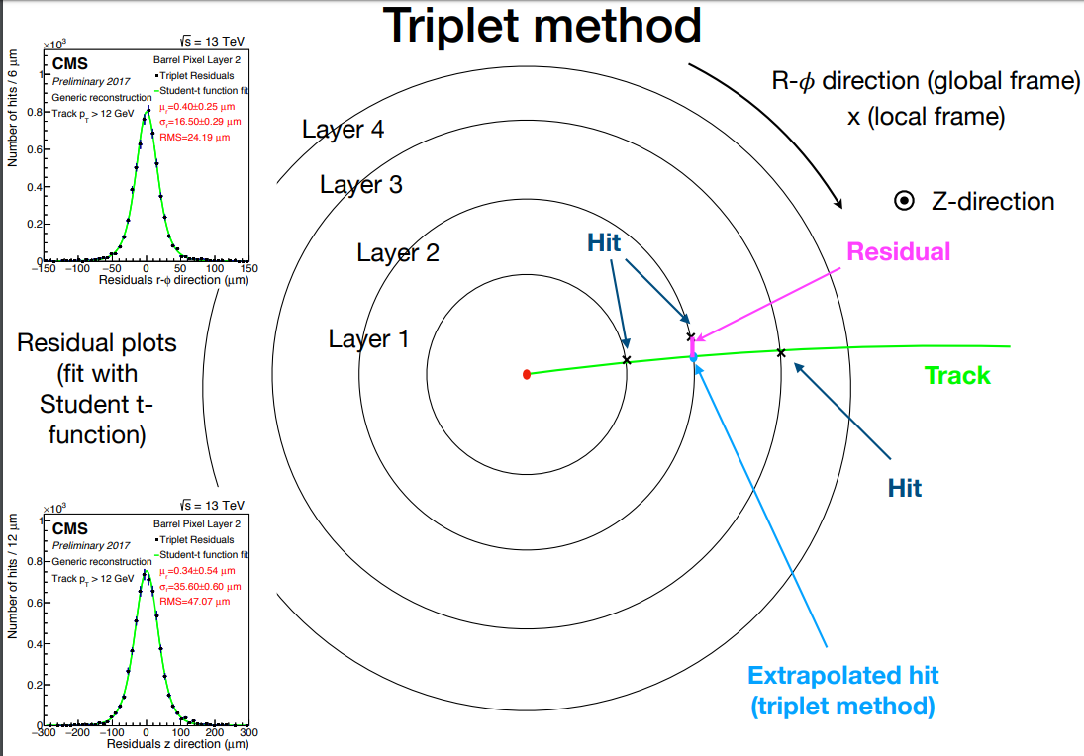
Pixel Calibration & Performance
Lorentz angle:
See the talk from Tanja showing the improved method to measure LA
Tools at DPGAnalysis-SiPixelTools/LA-Calibration
Resolution:
Using the triplet method
Tools at DPGAnalysis-SiPixelTools/PixelTriplets
Plot from Danyyl

Slide 4
Pixel Calibration & Performance
Hit efficiency and cluster properties:
On-track cluster charge and sizes are the important quantities for the assessment and monitoring of the detector conditions.
Cluster size in x (y) is sensitive to LA in BPix (FPix)
New hit efficiency method was developed using muons
Better match with the tracking results
SingleMuon dataset can be used
Tools at PhaseIPixelNtuplizer

Slide 5
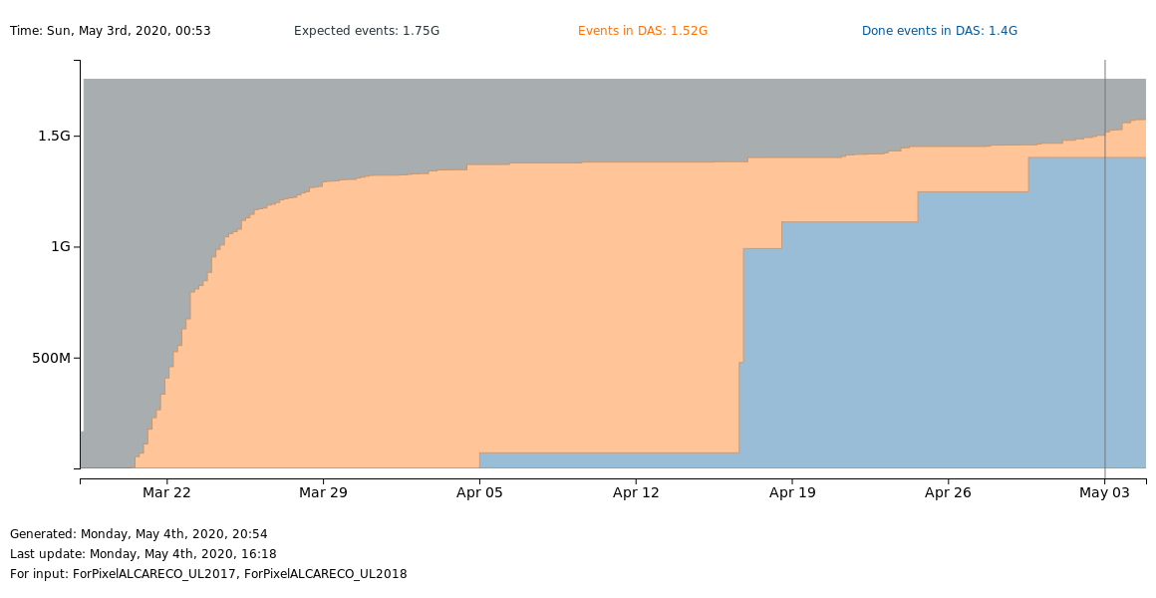
Pixel Calibration & Performance
For the performance paper we would like to have trend plots showing the changes in LA, resolution, cluster properties.
For this a new ALCA-RECO was developed, 2017/2018 production ongoing.
Files for 2016 are done:
DAS link

Slide 6
Pixel Calibration & Performance
Future of monitoring:
One tree based on the ALCARECO mentioned above
RAW files
LA trees
Resolution trees
PixelTrees
Trees for cluster properties
ALCARECO files
PixelMonitTrees

Slide 7
Pixel Calibration in Run-3
Timing scans:
See the talk from Redwan about the online changes
From the offline point of view:
  PhaseINtuplizer will be used
  Janos is responsible for the task
HV scans:
See the talk from Marton showing that ALCARECOs can be used for this
Furthermore a study about the z-dependence of the depletion voltage
Gain calibration:
See the talk from Izaak about the changes (VCal inclusion, etc)

Slide 8
CPE developments for Run-3
Cluster merging:
See the talk from Oz about what was done already and
The discussion today about the plans
CPE on GPUs:
See the session on Thursday
Generic algorithm:
Study ongoing to check the effect of assuming angles by the detector element position, instead of the track angles

Slide 9
Pixel database
Bad component determination at PCL:
Improvements planed: having a z-dependence in the compared occupancy value
Payload inspector:
Marco developed it for
  LA payload
  Gain calibration
  Templates
Next: GenErrors(?), Dynamic Inefficiency, Stuck-TBM

Slide 10
Pixel Simulation
Task | Status
Pixel Digitizer Developments | We desperately need somebody for these!
Charge reweighting
We need to prepare
for time dependent MCs and
use radiation damage for Phase-2 detector.
These are both urgent and important topics.

