Slide 1



Pixel Offline News
Danek KOTLINSKI¹ , Tamas Almos VAMI²
email: cms-pixel-offline-conveners@cern.ch
¹ Paul Scherrer Institut
² Johns Hopkins University
Pixel Offline meeting

Slide 2
Release schedule
UL release: CMSSW_10_6_8_patch1, now also CMSSW_10_6_11_patch1
CMSSW_11_1_0 schedule:
  CMSSW_11_1_0_pre5: out from 2 weeks ago
  CMSSW_11_1_0_pre6: 2020/04/14
  CMSSW_11_1_0_pre7: 2020/04/28 (last open pre-release)
  CMSSW_11_1_0_pre8: 2020/05/12 (closed cycle)
  CMSSW_11_1_0: 2020/05/28
PR from Danek in progress: PR29333

Slide 3
UL status
2018 is done, DAS link is here:
https://cmsweb.cern.ch/das/request?view=list&limit=50&instance=prod%2Fglobal&input=%2F*%2FRun2018*12Nov2019_UL2018*%2F*
2017 data is done, MC is finishing
https://cmsweb.cern.ch/das/request?view=list&limit=50&instance=prod%2Fglobal&input=%2F*%2FRun2017*09Aug2019_UL2017*%2F*
2016 data is like almost fully done, MC has not really started
https://cmsweb.cern.ch/das/request?view=list&limit=50&instance=prod%2Fglobal&input=%2F*%2FRun2016*21Feb2020_UL2016*%2F*

Slide 4
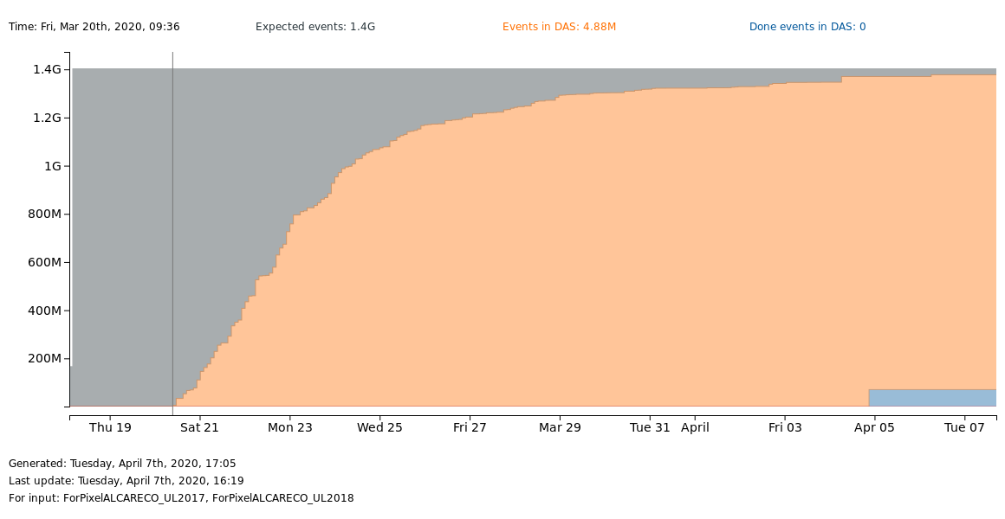
UL performance plots
Now that UL conditions are provided, we plan to check historic residuals, LA, charge properties and hit efficiency using the UL conditions
2016 is done, 2017/2018 very close to finish.
Cosmics are also very close

Slide 5
EPR 2020
EPR requirement is still 4 month. Please pledge!
EPR tasks and their allocation in the Pixel Offline group:
https://twiki.cern.ch/twiki/bin/view/CMS/PixelOfflineSoftwareResponsibilities#2020_Pixel_Offline_Tasks
Open tasks:
Code development for PixelCalibTrees (Kyle+somebody?)
Pixel simulation contact (???)
Reweighting code for Run3 and Phase-2 (???)

Slide 6
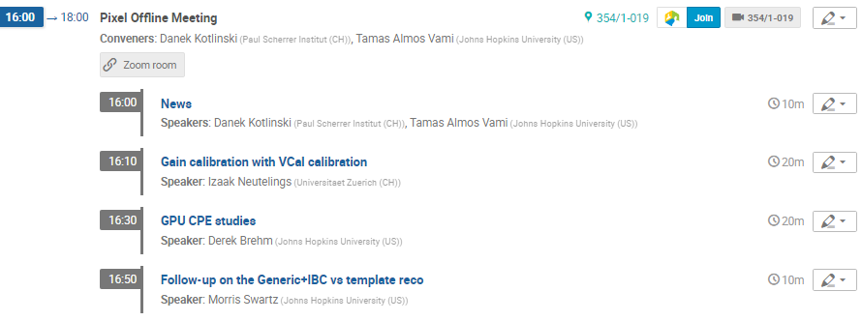
Agenda for today

