Slide 1


Pixel template reconstruction
Petar Maksimovic ¹, Morris Swartz¹, Tamas Almos VAMI¹
¹ Johns Hopkins University
HSCP meeting

Slide 2
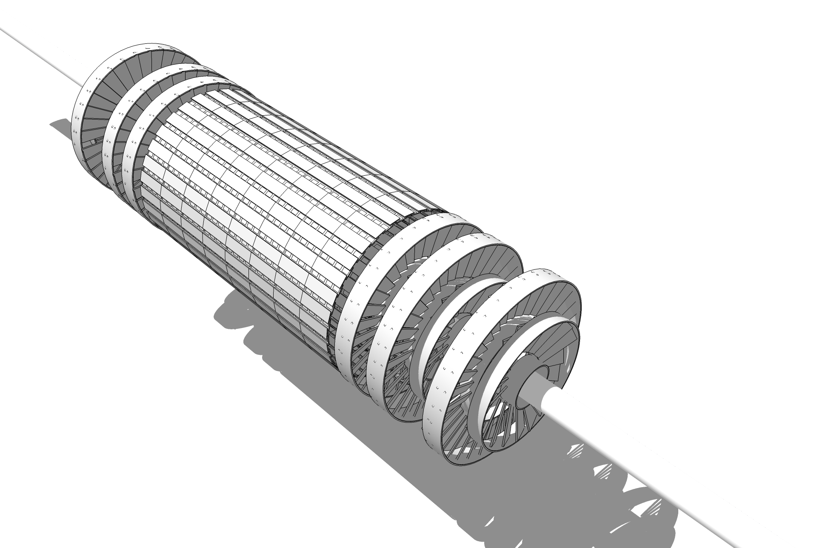
CMS Pixel Detector
3-3 disks
4 cylindrical layers
124 million pixels

Slide 3
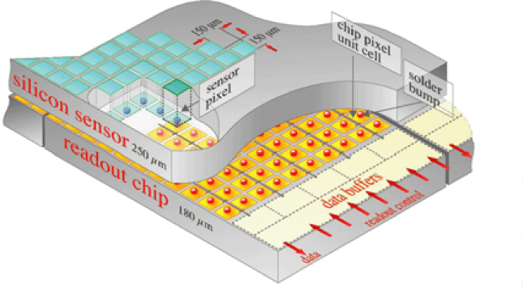
Pixels

Slide 4
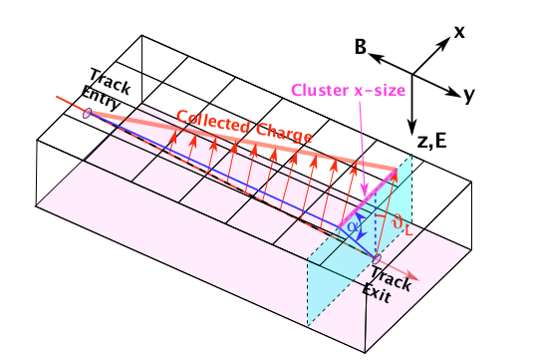
Pixels

Slide 5
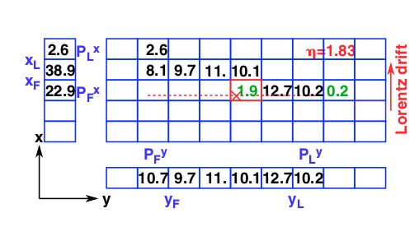
Pixels
A traversing particle creates charges which are read out in the x-y plane
Example cluster shape. Signals in each pixel are given in ke⁻.

Slide 6
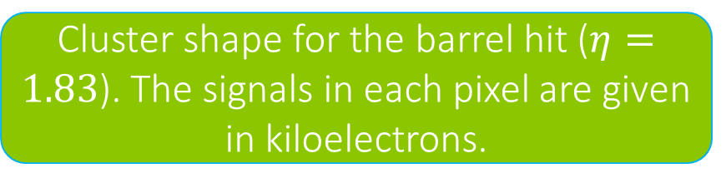
Template reconstruction
The current track reconstruction uses a special reconstruction method that was developed to simulate irradiated sensors using an external software called PixelAV.
These simulated charged shapes are stored in a database as 1D (2D) projections, called (2D) templates.
The x- and y-projections are shown as one-dimensional arrays on the plot on the left.
Cluster shape for the barrel hit ($η=1.83$). The signals in each pixel are given in kiloelectrons.
This technique leads to superior resolution,
especially for irradiated sensors.

Slide 7
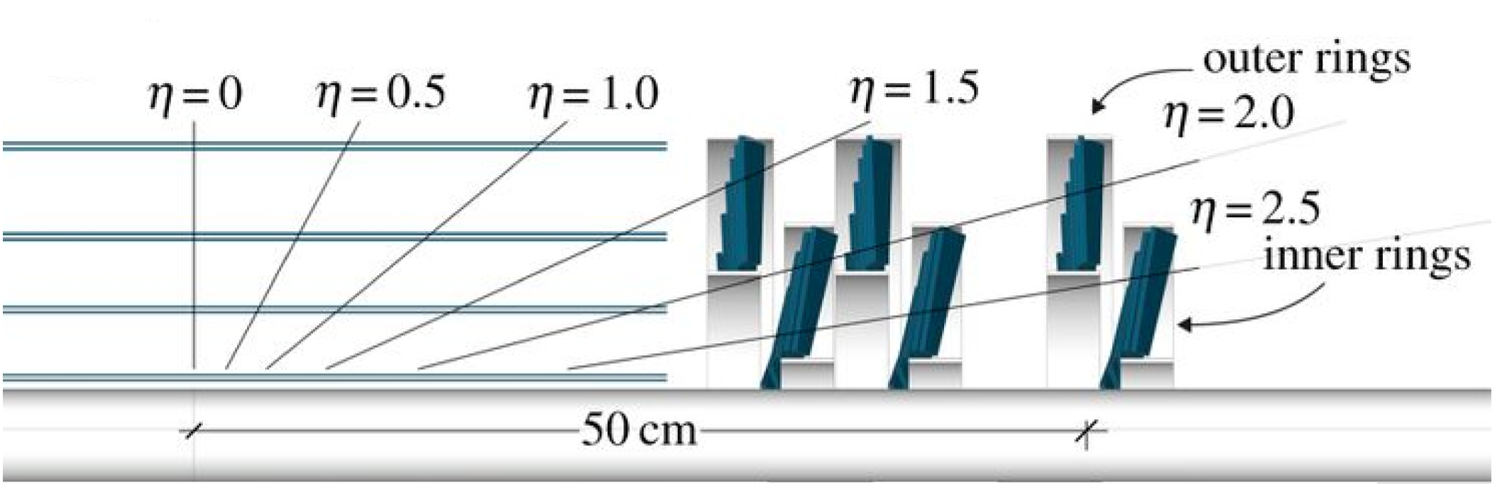
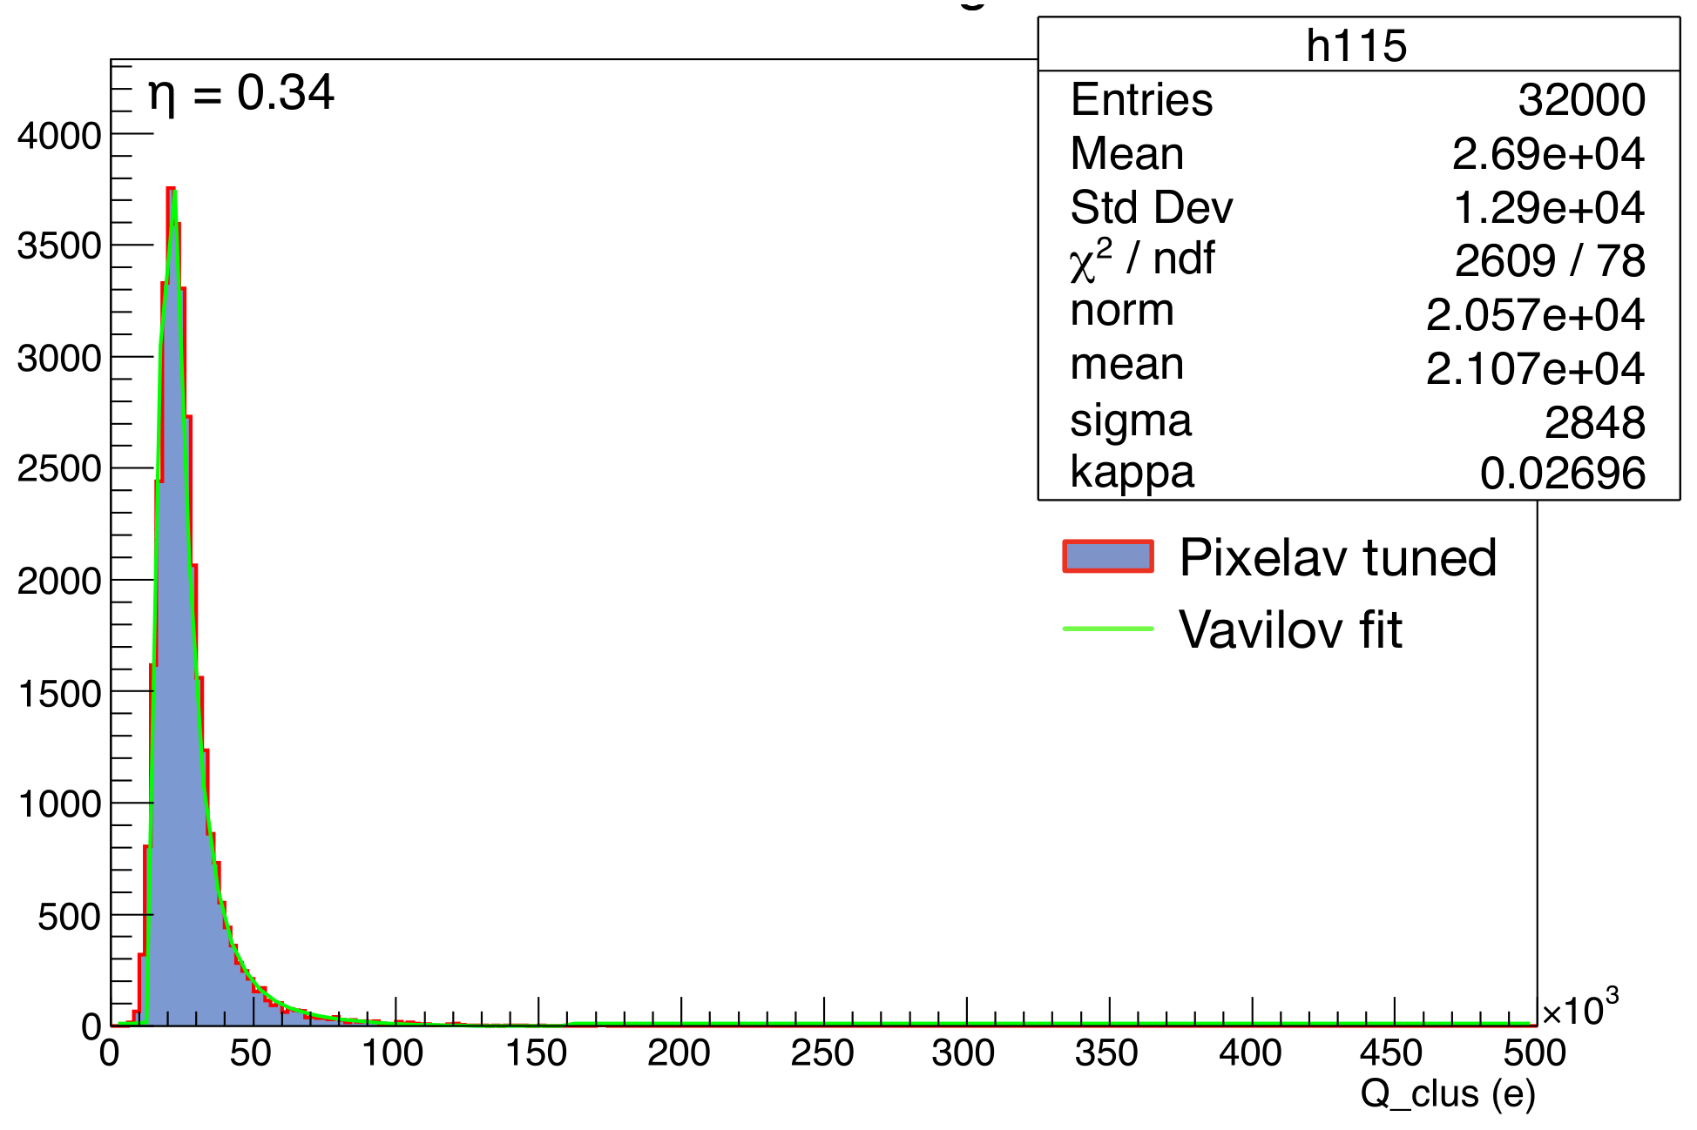
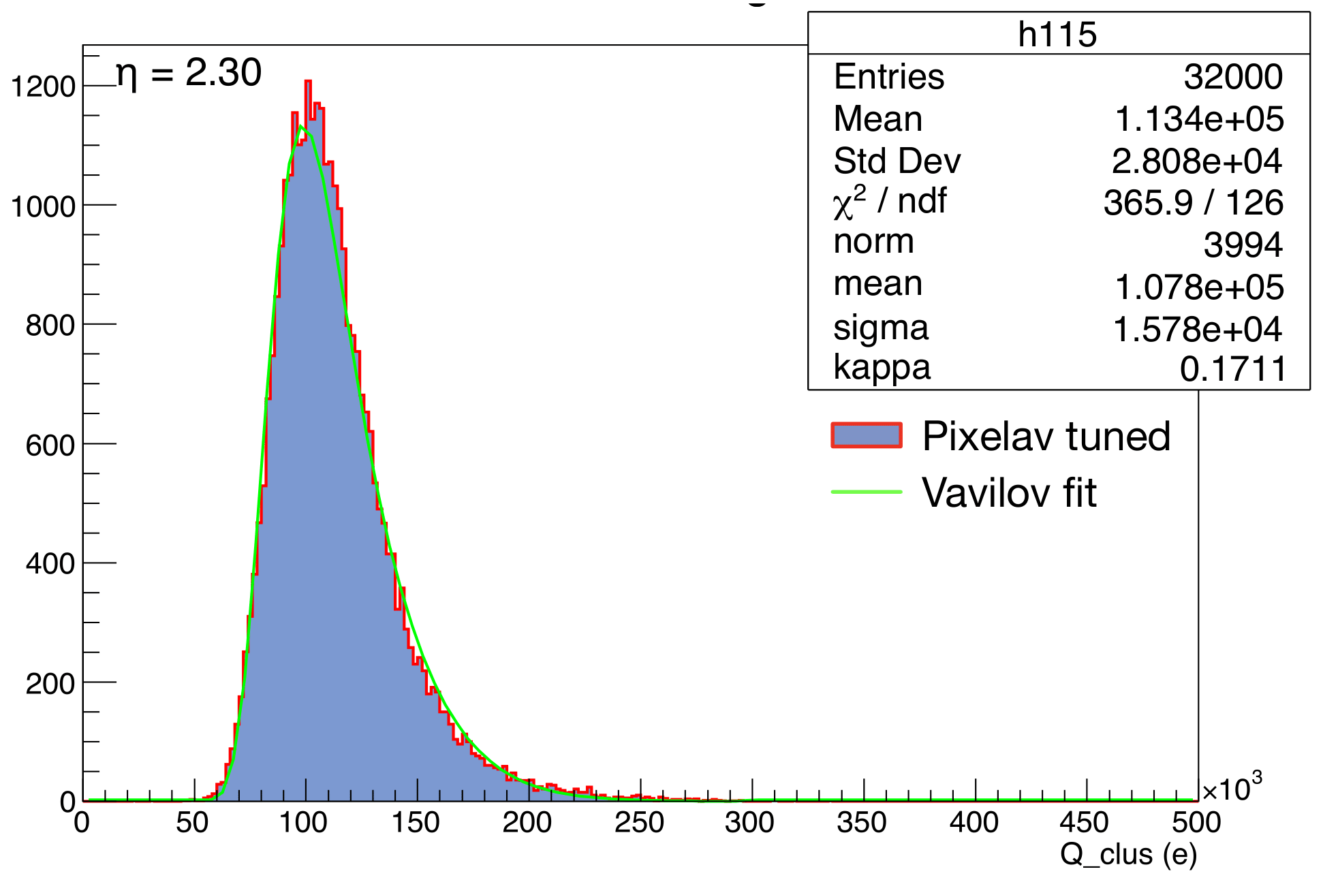
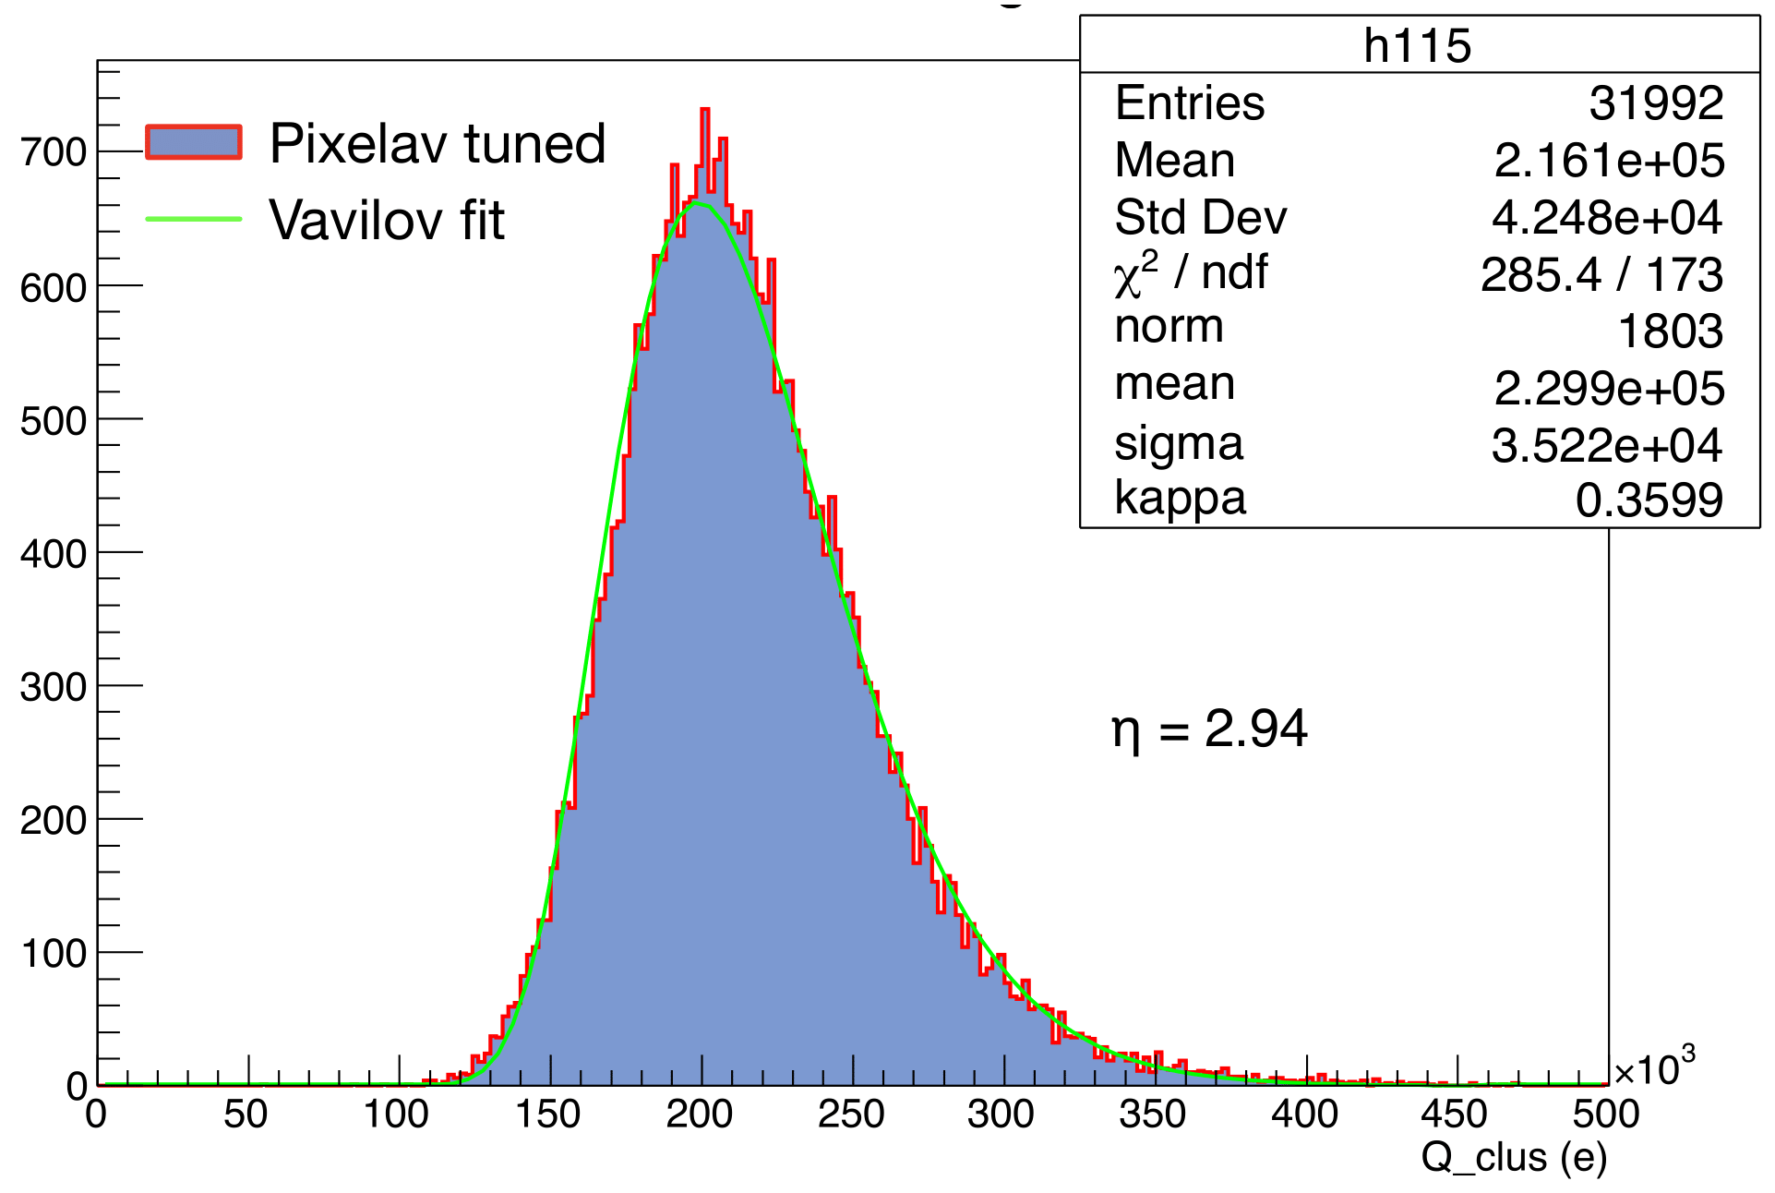



Template reconstruction
Cluster shapes are stored for several incident angles
$$η=0.34$$
$$η=2.30$$
$$η=2.94$$

Slide 8
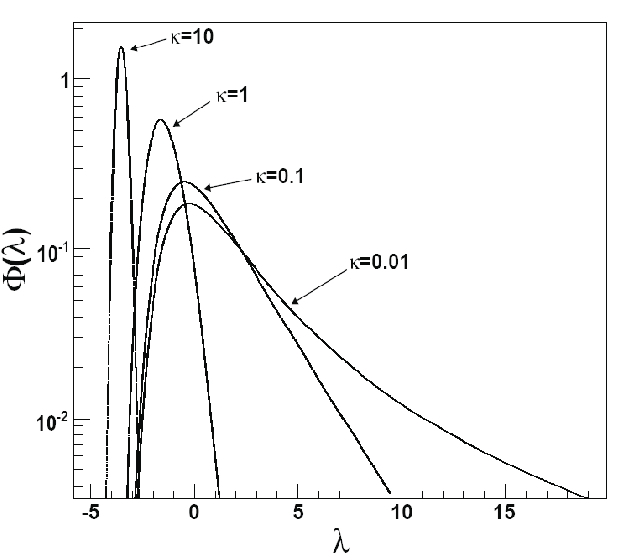
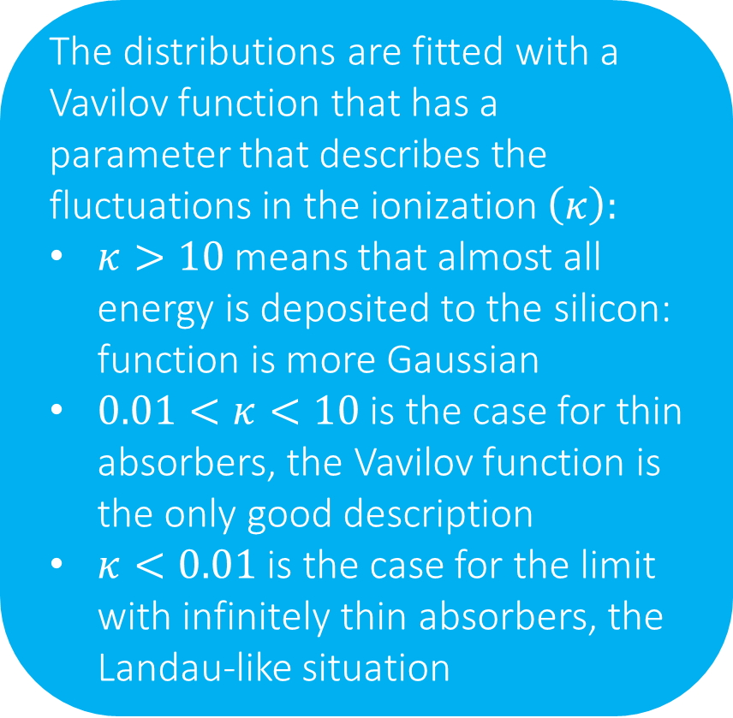
Template reconstruction
The distributions are fitted with a Vavilov function that has a parameter that describes the fluctuations in the ionization $\left(κ\right):$
$κ>10$ means that almost all energy is deposited to the silicon: function is more Gaussian
$0.01<κ<10$ is the case for thin absorbers, the Vavilov function is the only good description
$κ<0.01$ is the case for the limit with infinitely thin absorbers, the Landau-like situation

Slide 9
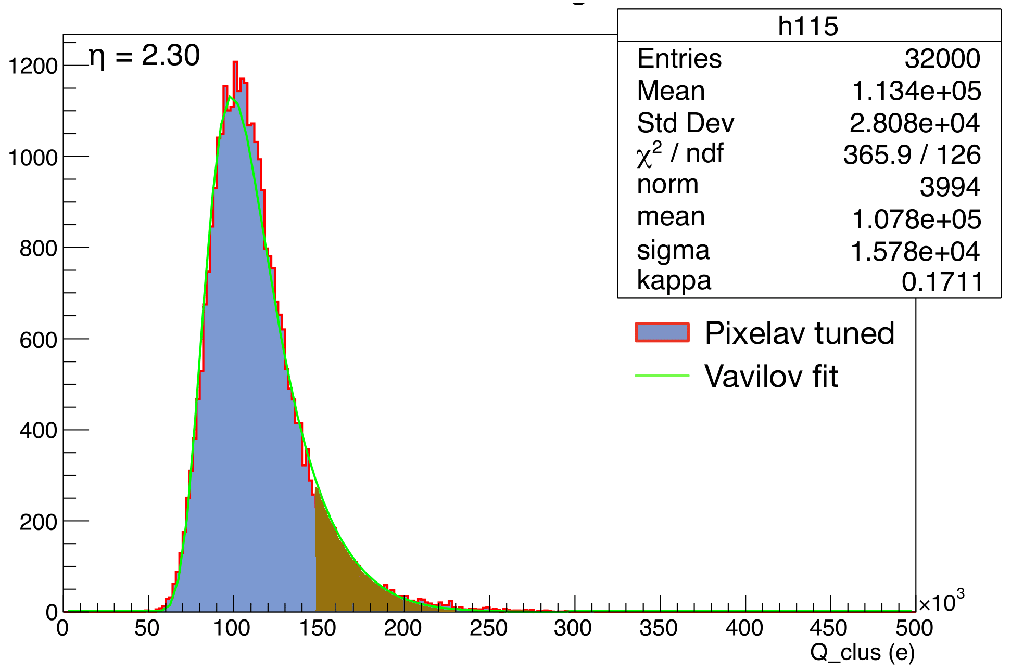
Template reco
Plan to exploit hitherto unused results of the template fit:
- ProbXY: describes cluster shape
- ProbQ: charge probability
ProbQ is understood for each cluster as the integral from the given cluster charge in the tail
Low ProbQ thus means high ionization

Slide 10
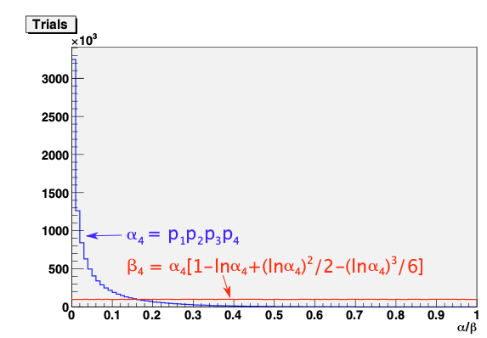
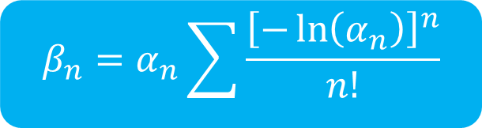
Combining probabilities
The probQ-s in the track are independent of each other and instead of multiplying them together we use a special combination technique introduced in a private note by Morris
$$β_{n}=α_{n}\sum{\frac{{\left[−\ln\left(α_{n}\right)\right]}^{n}}{n!}}$$
Plot from the note, using random numbers
With this we have a variable for the clusters on track, whose distribution is flat for SM particles
Important: This is flat independently of the choice of n. n=4 is the situation with 4 pixel layers, but can be done with less too. Including the strips increases this number and this works like that too.

Slide 11
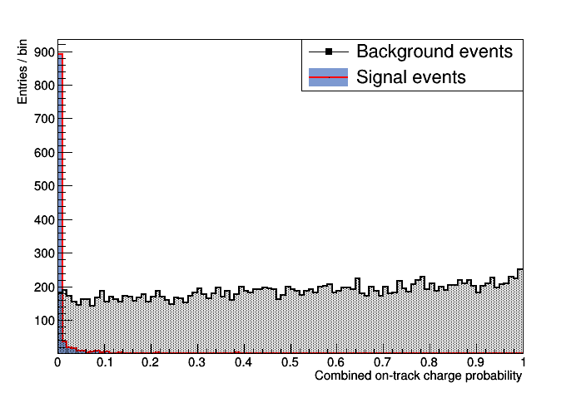
Proof of concept
The on-track charge probabilities combined with the method described above
The black curve shows SM events, while the red is for the events containing R-hadrons.
This variable is proven to be a very powerful discriminator between signal and background.

Slide 12
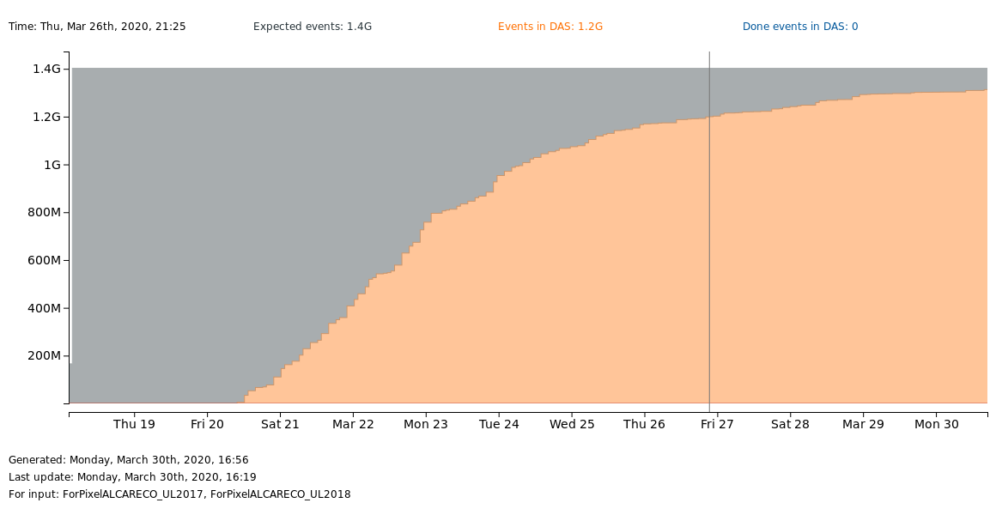
SingleMuon ALCARECO
The info is stored in the RecHit, so one needs to refit the tracks but to do that we need the recoTrackExtra information, which is not stored in AOD
I develop a RECO like format myself, containing information about the tracker only.
Central production is almost finished

Slide 13
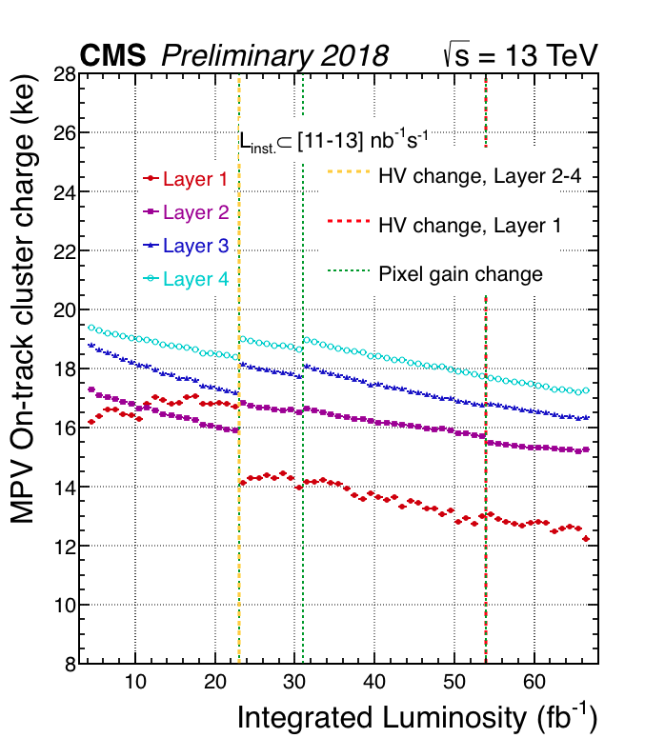
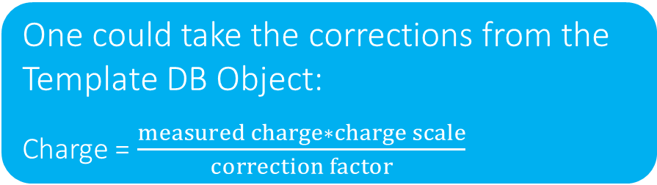
Charge trend
Charge for dEdx studies has to be constant over the years
One could take the corrections from the Template DB Object:
Charge = $\frac{measured charge∗charge scale}{correction factor}$
See my presentation last week to show the initial tests

Slide 14
Backup

Slide 15
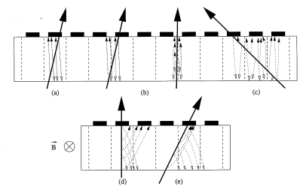
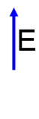
Charge sharing
Read-Out Chip

Slide 16
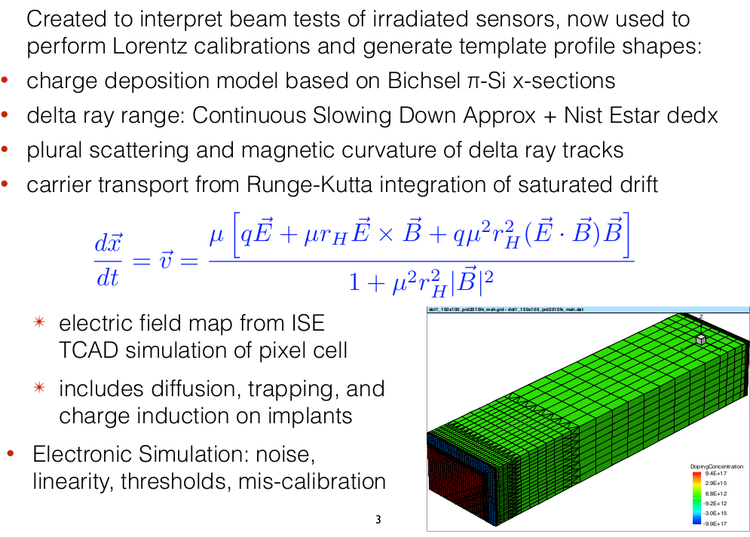
PixelAV

Slide 17
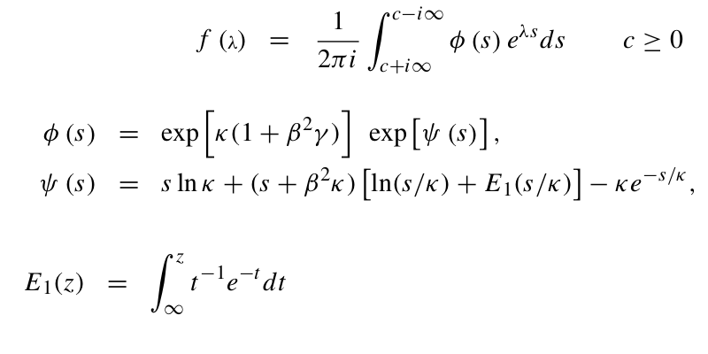
Vavilov function

Slide 18
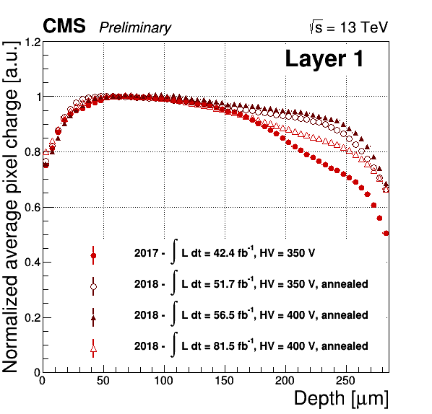
Why does the charge decrease?
For non irradiated, fully depleted detector, the pixel charge profile [normalised average pixel charge as a function of the production depth] is expected to be flat as detector is fully efficient and all charge is collected,
while for irradiated detector the losses are expected due to the trapping of carriers. The losses are larger for the charges released further from the readout plane

Slide 19
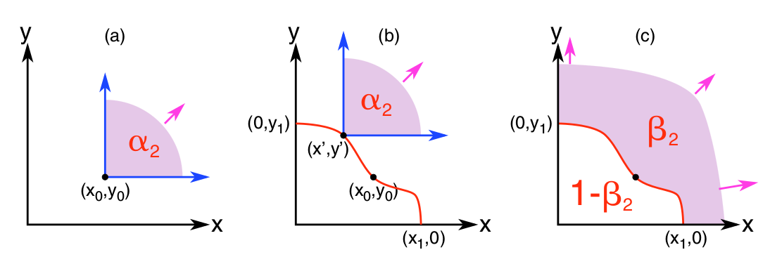
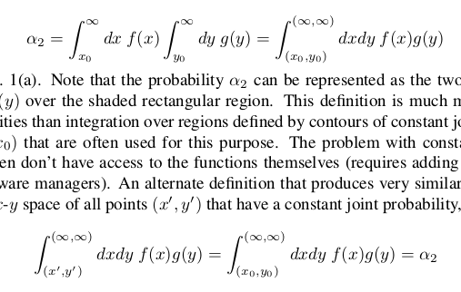
Combining probabilities (1)
Let x and y to be two independent random variables, which are distributed according to the differential probability distributions f (x) and g(y), respectively. Let x₀ and y₀ be the outcome of a single observation.
The simplest definition of the joint probability :
An alternate definition is to define a contour in x-y space of all points (x’ , y ’) that have a constant joint probability:

Slide 20
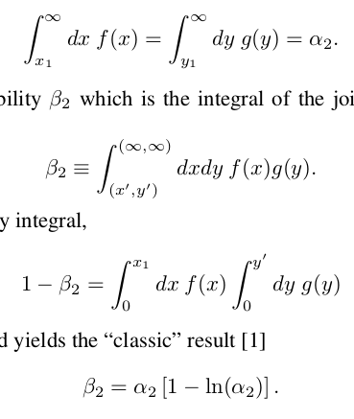
Combining probabilities (2)
Note that the endpoints of the contour are thus defined as:
We therefore define the new probability β which is the integral of the joint distribution function:
The evaluation of the complementary integral is easier:
And yields to

Slide 21
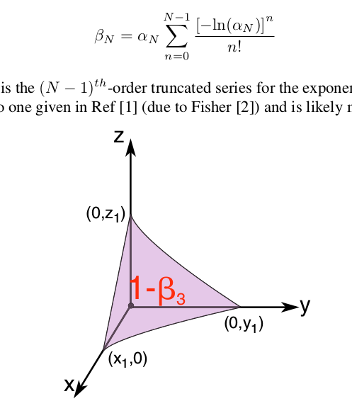
Combining probabilities (3)
Generalization to N dimensions leads to the formula
Hypersurface for 3D:

